Slide 1
Capstone Project 2: Chest X-Ray Image Classification Using Deep Learning
Jonathon Poage
Springboard Data Science Career Track
ADD DATE

Slide 2
Outline
Introduction
Data
Raw Data
Processed Data
Analysis
General Image Properties
Analysis parts 2 and 3 in progress
Conclusion

Slide 3
Introduction

Slide 4
Problem
Pneumonia is the leading infectious cause of death for children worldwide.¹
Fatalities are most common in developing areas of the world.
Low cost treatments are available. Fatalities could potentially be reduced if patients are efficiently diagnosed and referred for treatment.
The issue is that fast and accurate diagnosis of pneumonia can be challenging in facilities that have limited resources.

Slide 5
Pneumonia Diagnosis
The two leading causes of pneumonia are:
Bacteria
Viruses
Bacterial and viral pneumonia require different treatments.
Accurate diagnosis is essential to refer patients for proper treatment.
Diagnosis commonly involves inspecting chest radiograph (X-ray) images for signs of inflammation in the lungs.²
Interpretation of chest X-ray images requires time and expertise, which may not be abundant in facilities with limited resources.

Slide 6
Goal of Analysis
The overall goal is to facilitate diagnosis of pediatric pneumonia.
The immediate goal is to provide a fast, automated, and accurate method for interpreting chest X-ray images.
These goals will be accomplished by developing a classification model that predicts the presence or absence of pneumonia in patients, based on chest X-ray images. The model will distinguish between bacterial and viral pneumonia.

Slide 7
Benefit of Results
Clinicians could save time by automatically interpreting chest X-ray images when diagnosing patients.
Facilities with limited resources could gain the means to quickly and accurately diagnose bacterial and viral pneumonia, which would facilitate rapid referral for treatment.
Clinical outcomes could potentially improve worldwide for patients with pneumonia.

Slide 8
Data

Slide 9
Chest X-ray Image Data
The raw data was downloaded from the following website: https://data.mendeley.com/datasets/rscbjbr9sj/3.³
The raw data was prepared and labeled by Kermany et al.⁴
The raw data set contains thousands of anterior-posterior chest radiograph images from Guangzhou Women and Children’s Medical Center.
The chest X-ray imaging was performed on pediatric patients ranging from 1-5 years old as part of routine clinical care.
The image filenames contain the following information:
Image class (Bacterial Pneumonia, Viral Pneumonia, or Normal)
Patient ID
Image number by patient

Slide 10
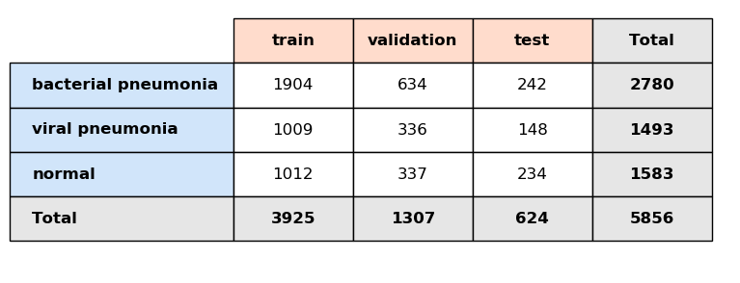
Data Processing
The image files were sorted into train, validation, and test sets.
A pixel intensity array of dimensions 224 x 224 x 3 in RGB color mode was created for each image file.
Feature and target arrays were prepared for analysis.
File Counts for the Image Classes and Data Sets

Slide 11
Analysis Part 1
General Image Properties

Slide 12
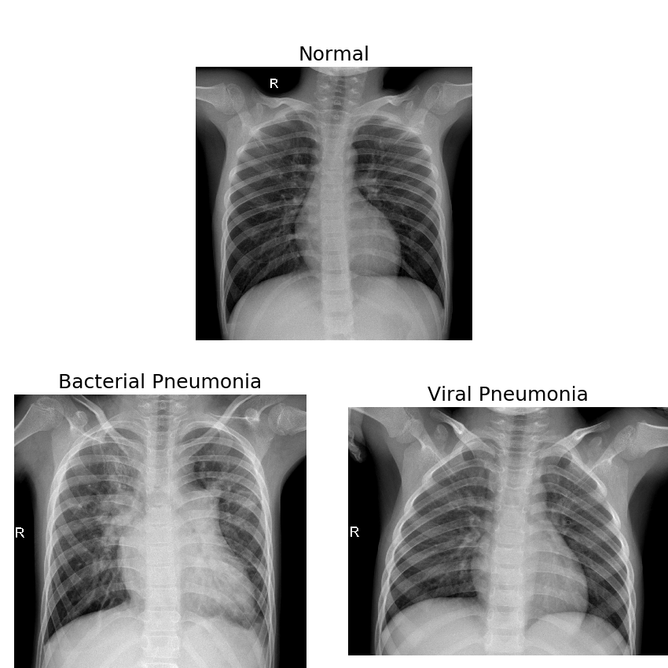
Sample Images
The normal image depicts clear lungs.
The bacterial and viral pneumonia images exhibit abnormal pulmonary opacification.
Bacterial pneumonia chest X-rays typically have concentrated opaque areas.
Viral pneumonia chest X-rays typically display more diffuse patterns of opacity.

Slide 13
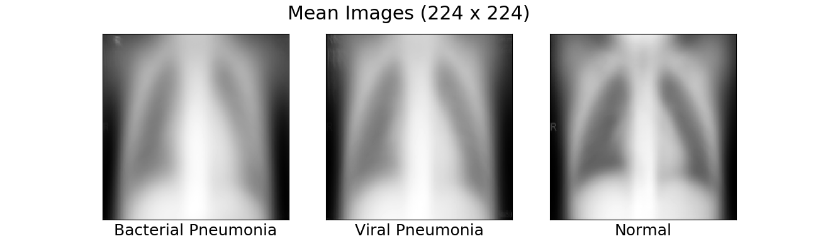
Mean Images
The mean images show the average pixel intensities for each image class.
The areas in the rib cage are darker in the normal mean image than the corresponding areas in the pneumonia mean images.
The subtle differences between the bacterial and viral pneumonia mean images are not visually apparent.

Slide 14
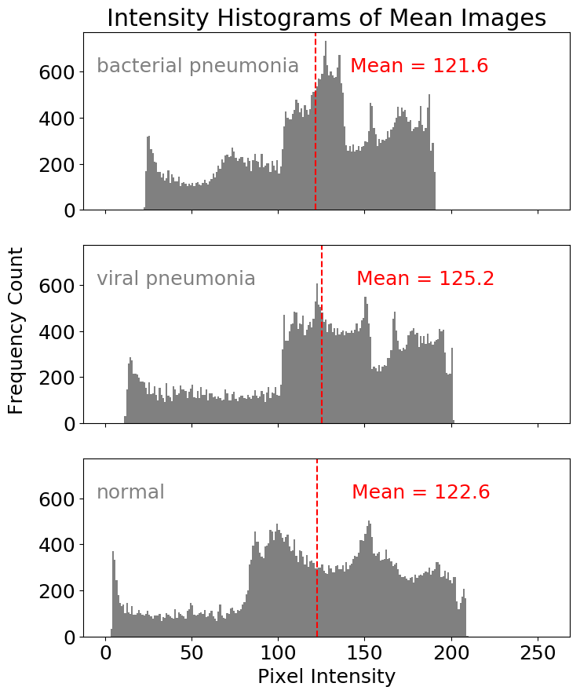
Mean Image Intensity Histograms
Pixel intensity values range from 0 (black) to 255 (white).
The distributions show peaks at different locations. Overall, the predominant pixel intensities vary by image class.
The viral and bacterial mean images have larger proportions of grey and light grey pixels compared to the normal mean image.
The normal mean image has a larger proportion of near black and dark grey pixels compared to the pneumonia mean images.

Slide 15
Next Steps
IN PROGRESS

Slide 16
Outline of Next Steps
IN PROGRESS
Analysis part 2: build image classification models.
Analysis part 3: evaluate and compare performance of the models.
Summary
Recommendations
Future Work

Slide 17
References
Pneumonia. World Health Organization Web site. https://www.who.int/news-room/fact-sheets/detail/pneumonia. Published November 7, 2016. Accessed April 30, 2019.
Pneumonia. National Heart, Lung, and Blood Institute Web site. https://www.nhlbi.nih.gov/health-topics/pneumonia. Accessed April 30, 2019.
Kermany D, Zhang K, Goldbaum M. Large dataset of labeled optical coherence tomography (OCT) and chest X-ray images. Mendeley Web site. https://data.mendeley.com/datasets/rscbjbr9sj/3. Published June 1, 2018. Accessed April 13, 2019.
Kermany DS, Goldbaum M, Cai W, et al. Identifying medical diagnoses and treatable diseases by image-based deep learning. Cell. 2018;172(5):1122-1131. doi:10.1016/j.cell.2018.02.010.

